Slide 1
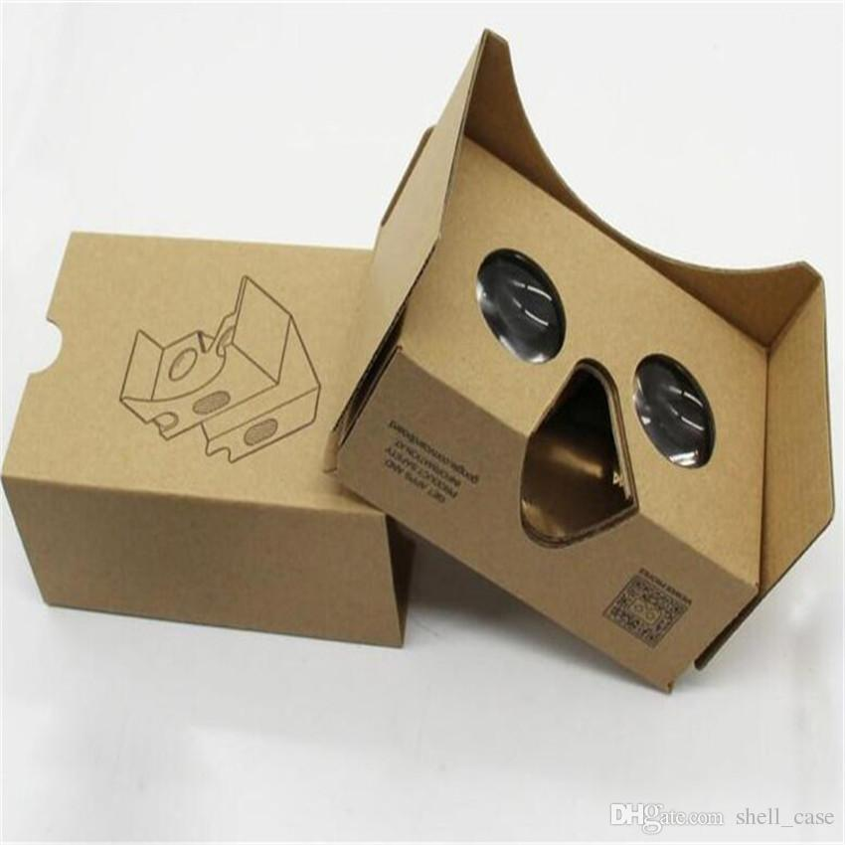
Pond Activity: 360 Pond Virtual Reality
Take some time to check out the 360 virtual reality photos
Answer the following:
What time of year is it?
What are some of the organisms in the picture?
Do you know their names?
What would you expect to see in a pond?

Slide 2
Seasonal Lake Turnover: Temperature and Water Mixing
Created By:
Appalachian Watershed Research Group
The Voinovich School of Leadership & Public Affairs
Ohio University
A special thanks to the AEP Foundation!

Slide 3
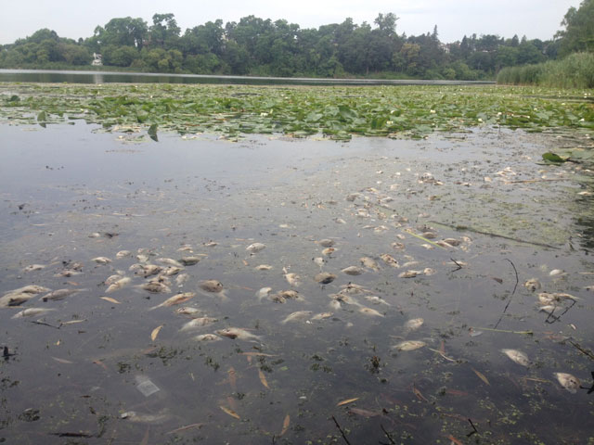
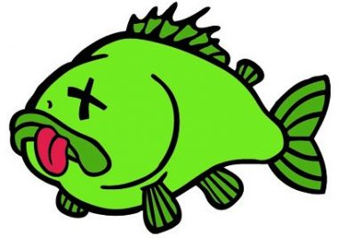
Fish Kills: What happened?

Slide 4
Fish Kills
The term “fish kill” is used to describe the sudden large die off of a large number of fish
Causes:
Overabundant aquatic vegetation or planktonic algae
Fish Disease
Turnover Event
Pollution
KY Fish and Wildlife : https://fw.ky.gov/Fish/Pages/Farm-Pond-Management-Water-Quality.aspx

Slide 5
What is the Cause of Fish Kill at Mr. Water’s Pond?
Lack of Dissolved Oxygen
Why does lack of D.O. kill fish?
What causes the D.O. to decrease?

Slide 6
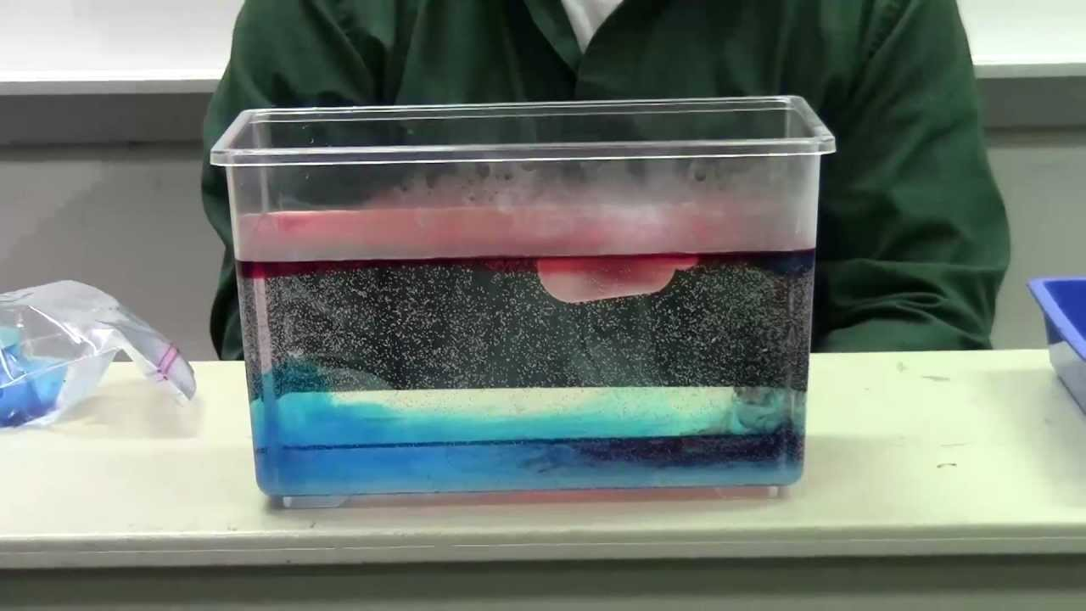
Background Principles
Have you ever been swimming and the deeper you went the cooler the water became?
Warm water rises, cold water sinks (same as air)
In summer months there is warming of the top layer of the water due to air, temperature and sunlight
Sunlight can’t penetrate throughout the entire water column, particles, such as dirt, create turbidity and do not let the light pass through
Therefore the bottom layers remain cool– this is called stratification

Slide 7
Pond Stratification
There is less oxygen in the lower layers.
Why would this be?
https://fw.ky.gov/Fish/Pages/Farm-Pond-Management-Water-Quality.aspx

Slide 8
Respiration
Oxygen-in, carbon dioxide-out
This type of respiration occurs in many organisms– us!
Including those who live at the bottom of the pond
Dead organisms sink to the bottom of the pond and are consumed by decomposers
Decomposers consume and multiply
Consuming oxygen
Bottom layer doesn’t have much oxygen now, and is stratified (no mixing) with the other more oxygenated layers
Think photosynthesis on top of pond, carbon dioxide-in, oxygen-out

Slide 9
The “Flip”
Photosynthesis slows in cold months
The oxygenated top layer (epilimnion) is exposed to cold air, and wind
Mixing between the layers
Cold water begins to sink to the bottom, warmer water rises to the top
Cold oxygenated water is at the bottom of the pond, warmer unoxygenated water rises
What happens when there is no longer oxygen in the top layer of the pond?

Slide 10
Dead fish ☹

Slide 11
Mr. Water’s Fish Killer is…
Seasonal Turnover Event!
Changes in water temperature and oxygen levels that occur every fall can kill fish!
Recapping:
Plants create oxygen, keeping the top layer of water well-oxygenated
Temperatures change, killing plants and causing the top, oxygenated layer of water to sink to the bottom
Fish in the top layer suffocate without oxygen!
=
Dead Fish

Slide 12
How Can Mr. Water’s Prevent Fish Kill?
Work together in your small groups to create a one-paragraph proposal to help Mr. Water’s prevent fish kills in the future.
Use Expert Sources (provided by teacher) to research possible solutions.

Slide 13
Special Thanks To:
Appalachian Watershed Research Group
The Voinovich School of Leadership & Public Affairs
Ohio University
AEP Foundation

